Slide 1
Die formaat van ‘n dekbrief
Graad 9

Slide 2
What is a “dekbrief”?
A “dekbrief” is a cover letter.
The purpose of the cover letter is to introduce yourself to a company and to demonstrate that you are interested in a job that was advertised.
The cover letter usually go with a cv.
Often this letter is the first contact you have with a prospective employer.

Slide 3
A “dekbrief” has a very specific format that needs to be followed:
You address goes in the top right hand corner with the date. (TIP: memorise an address. This will be your Afrikaans address for ALL letters from now until grade 12.)
The person you are sending this letter to is written on the left side after you’ve skipped one line. The address is usually the one that is given as part of the task.In this case is will be:
Die Bestuurder
Mnr. de Beer
Posbus 1423
Johannesburg
2000

Slide 4
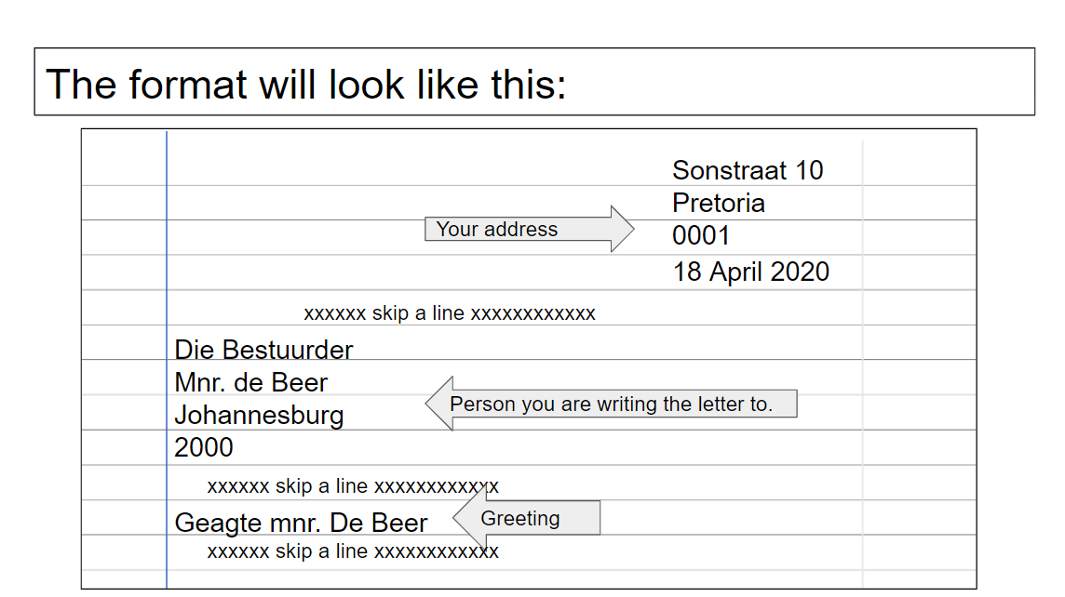

Slide 5
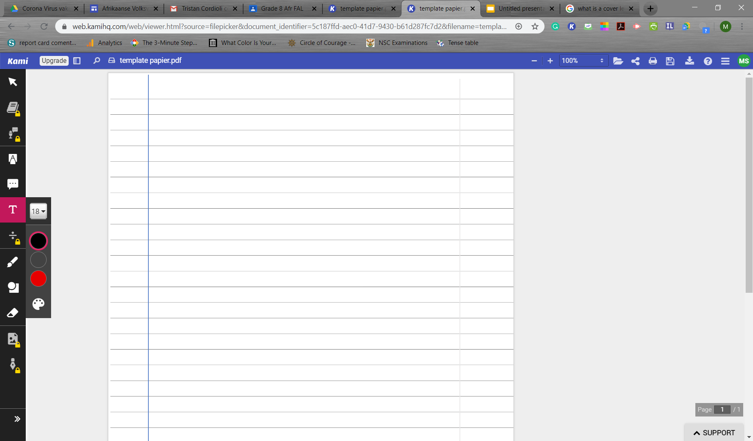
Format (continue)
This is a formal letter: You need to greet the person to which this letter is addressed, in this case it is Geagte mnr. De Beer.
Skip a line after the greeting.
The next step will be to write the purpose of this letter. The format will always follow the example given in BOLD. There are two ways to do this:
  All in capital letters
  Normal sentence format BUT you need to underline it.
AANSOEK OM BETREKKING: (name of the job applying for in CAPS)
Aansoek om betrekking: (name of job applying for in normal sentence format)

Slide 6
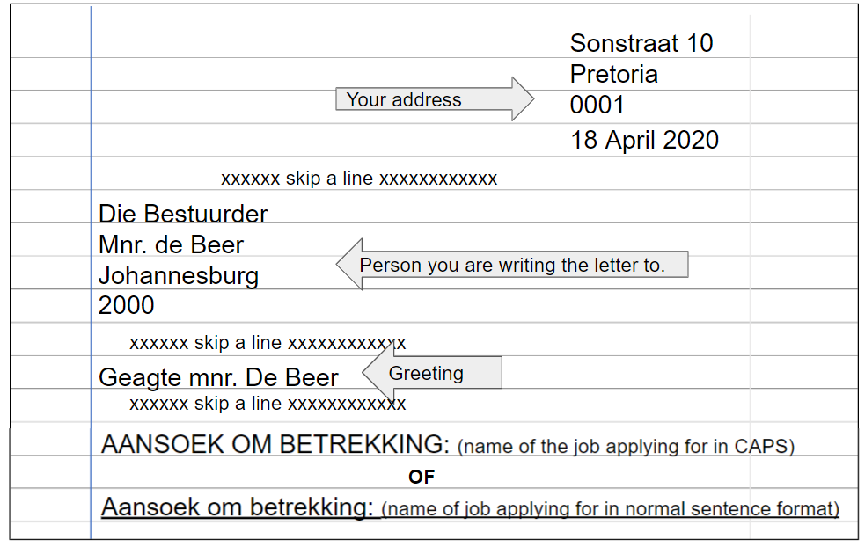

Slide 7
Format (INLEIDING)
The introduction follows a recipe as well basically stating that I am applying for the job stated above that was advertised in a particular newspaper on a particular day.
xxxxxx skip a line xxxxxxxxxxxx
Ek doen graag aansoek om bogenoemde betrekking soos in die Die Beeld van 21 Februarie 2020 geadverteer.
xxxxxx skip a line xxxxxxxxxxxx

Slide 8
Format (LIGGAAM)
The BODY must show that your skills and experience match the skills and experience needed to do the job. The body is usually written in 2 paragraphs.
The assignment gave you a list of skills and experience needed to apply successfully. Read the requirements carefully.
Focus on the following: Your name, contact number, qualifications, other important information and achievements, job experience and references.

Slide 9
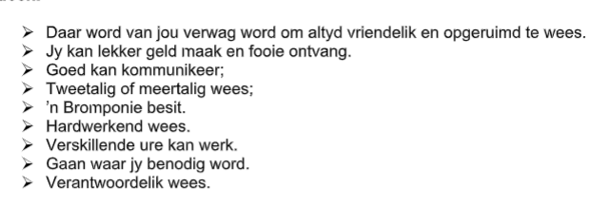
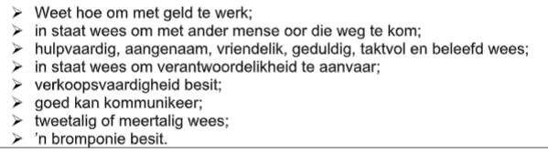
Pizza-aflewering
Kelner/Kelnerin

Slide 10
Format (SLOT en AFSLUITING)
The conclusion and ending is also a recipe to memorize.
Wees verseker van my lojaliteit en harde werk indien my aansoek suksesvol is. Ek hoop om gou van u te hoor.
xxxxxx skip a line xxxxxxxxxxxx
Die uwe
xxxxxx skip a line xxxxxxxxxxxx
(your signature)
Your name and surname

